Slide 1

Making the most of
your membership

Slide 2
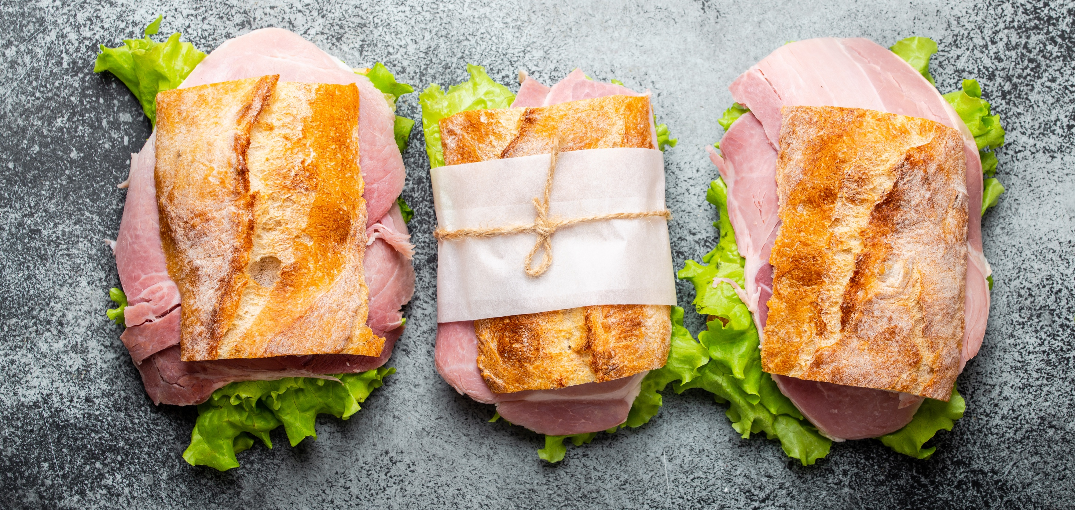

Who we are
We’re the voice of the sandwich and food-to-go industry in the UK, enabling our members to do business more effectively and helping them challenge legislation and other factors that could be damaging to their businesses.

Slide 3
How we support and protect your industry
We provide a platform for you to grow, bringing you together with like-minded industry professionals; representing your voice in Westminster; and providing extensive guidance around implementation
of legislation that’s relevant for your business.

Slide 4

Nine reasons to join
Access to our technical support and Assured Advice
Opportunities for insights & networking
Make sure your voice is heard in government
Be part of our technical sessions that shape industry best practice
Subscriptions to the most relevant publications for the food-to-go sector
Stay informed and up to date around issues that impact how you do business
Save money on The Sammies
Co-marketing opportunities, & the chance to position yourself at the heart of the industry
Discounts on Insurance and other services

Slide 5

Technical expertise – advice and support
We will help your technical team obtain the best advice when they need it.
All our members are covered by our Primary Authority Agreement, which means we can get advice on the interpretation of legislation from Government sources that is Assured and difficult for EHO’s to challenge.
Furthermore, members can use the Association’s agreement to clarify issues raised by EHO’s or to check things like the legality of wording on labels.
Members also have access to the Association’s Technical Manager and our helpline service which provides free telephone guidance on health & safety as well as employment matters.

Slide 6
Make sure your voice is heard in government
As a Stakeholder, recognised by Government as representing the sandwich and food-to-go sector, we are there to represent the interests of our market, providing a voice both collectively and individually for all our members.

Slide 7
Opportunities for insights and networking at member only briefing sessions
As a member we’ll provide you with opportunities to meet and network with contacts from across the sandwich and food-to-go industry at exclusive Association events, where you’ll have the chance to learn about latest industry trends and hear from industry leaders and innovators.
You’ll have the chance to join at least three of these exclusive sessions per year in London.

Slide 8
Stay informed and up
to date around issues
that impact how you
do business
We know your business and the issues that matter to you, so we will let you know about important developments, whether around legislation or key market developments, that could directly affect your business.
We’ll also give you access to the full minutes from our Board meetings where we discuss issues and decide on policy so that you can keep up-to-date with what the Association is doing.
Plus, you’ll receive our quarterly updates, where we share all that’s happened in the past three months and flag up what to expect in the three months ahead.

Slide 9
Technical expertise – sessions to build and
share knowledge
Your technical team will also be able to attend specialist briefings and networking sessions – distinct from our broader membership sessions – at least twice a year and they will be able to have input into developing guidance for the industry.

Slide 10
Subscriptions to the most relevant industry publications for the sector
You will receive two key sector magazines, Sandwich and Food-to-go News, and Café Life, as part of your membership.
These bi-monthly publications will help to keep you up-to-date with the latest trends and developments in the industry, including what others are doing in the market.

Slide 11
Save money on the Sammies
Your businesses will also benefit from discounted rates at key Association events, including the popular Sammies awards, the annual celebration of all that’s best in our industry.
And don’t forget you can always enter the awards as well.

Slide 12
Co-marketing opportunities
From time-to-time there are opportunities for members to be involved in co-marketing opportunities such as around British Sandwich Week.
Each May the Association undertakes an intense media campaign to promote sandwiches and associated products, reaching over 30 million consumers. The Week also features on posters across the rail network.
Members can take advantage of this by linking their own marketing to the campaign. If you’re looking to cement your position at the heart of the industry, this is a great opportunity to do so.

Slide 13
Savings on relevant products and services….
Member businesses have access to preferential rates on a range of key services.
Plus, we can introduce you to a variety of partners specialising in our sector, across aspects such as finance, PR and social media.

Slide 14
What it costs
Retail membership costs just £45 + VAT per annum per retail site up to a maximum fee of £2,450 + VAT per annum for multiple site membership.
For further information and to join us simply email
sandra@sandwich.org.uk

